Slide 1

Sprocket Central Pty Ltd
Data analytics approach
[Division Name] - [Engagement Manager], [Senior Consultant], [Junior Consultant]

Slide 2
Agenda
Introduction
Data Exploration
Model Development
Interpretation

Slide 3
Introduction
Aim : Boost business by analyzing existing customer dataset for customer trends and behavior.
Process involves the following stages
Business
understanding
Data
exploration
Data
preparation
Model
Development
Interpretation of results

Slide 4
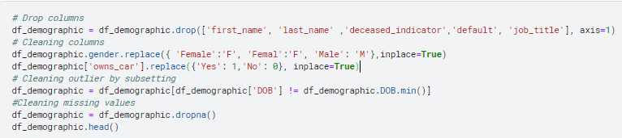
Data Exploration
Understanding the data
Variable Identification
Missing values treatment
Converting the inconsistent datatype to proper format
Outlier treatment

Slide 5
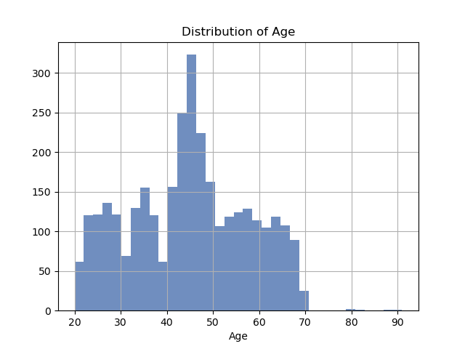
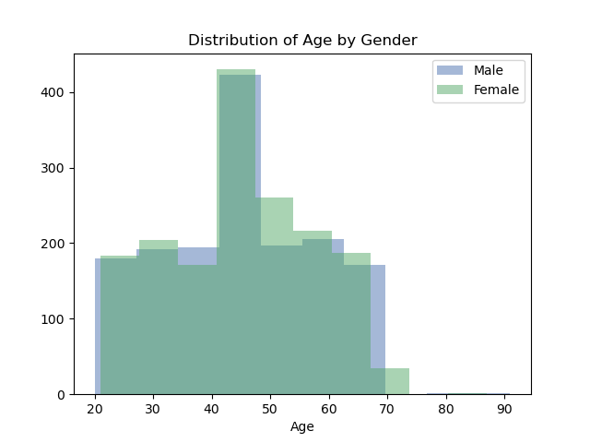
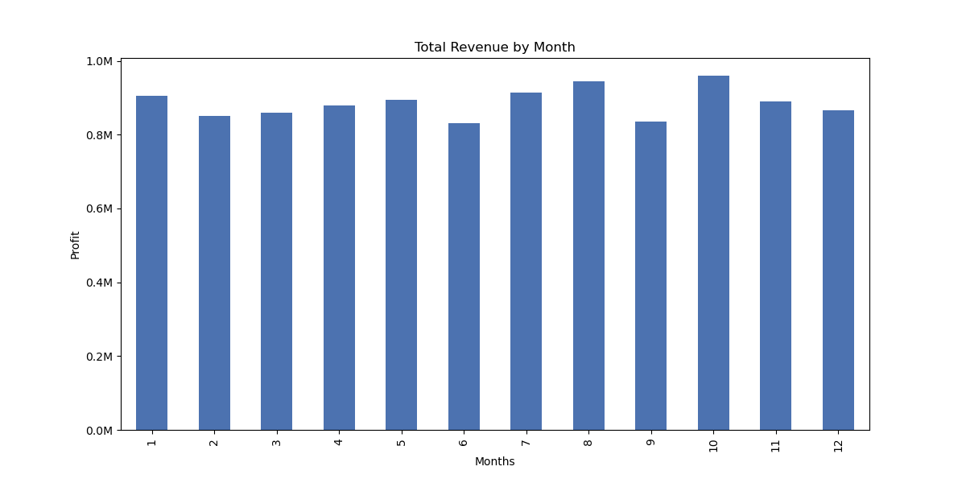
Data Preparation
Feature creation for analysis
Age Group determined using age distribution
Profit, Month column is created for analysis
Annual sales calculated

Slide 6
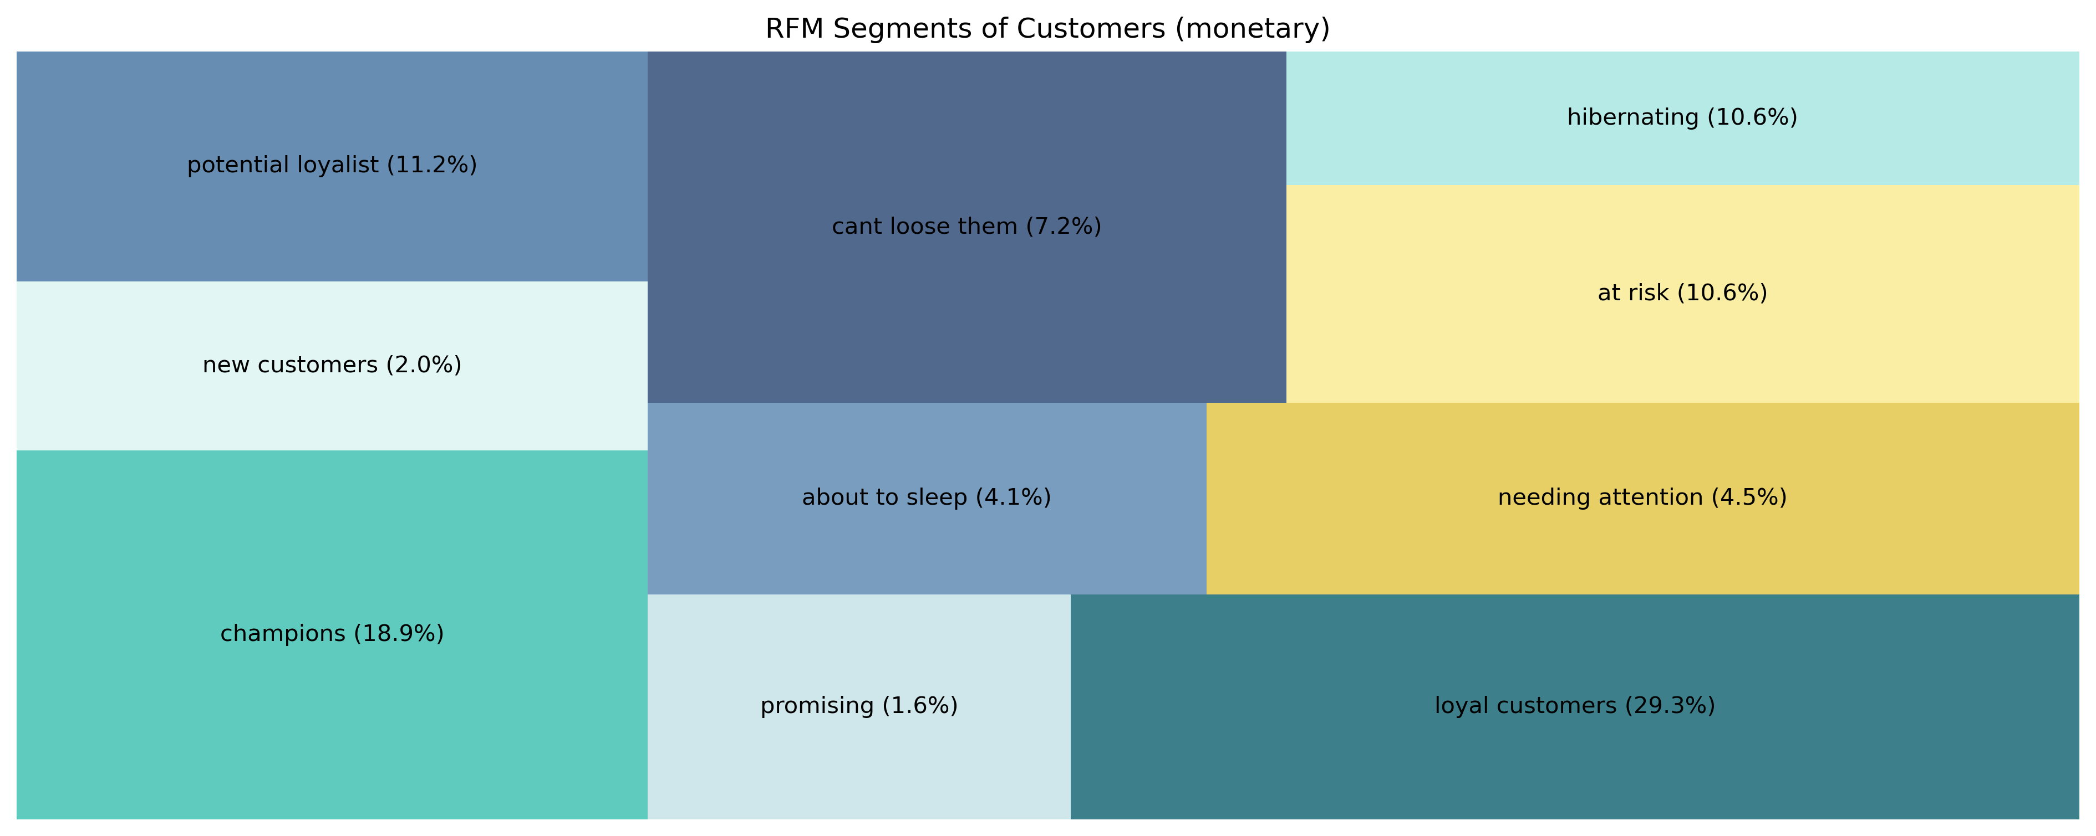
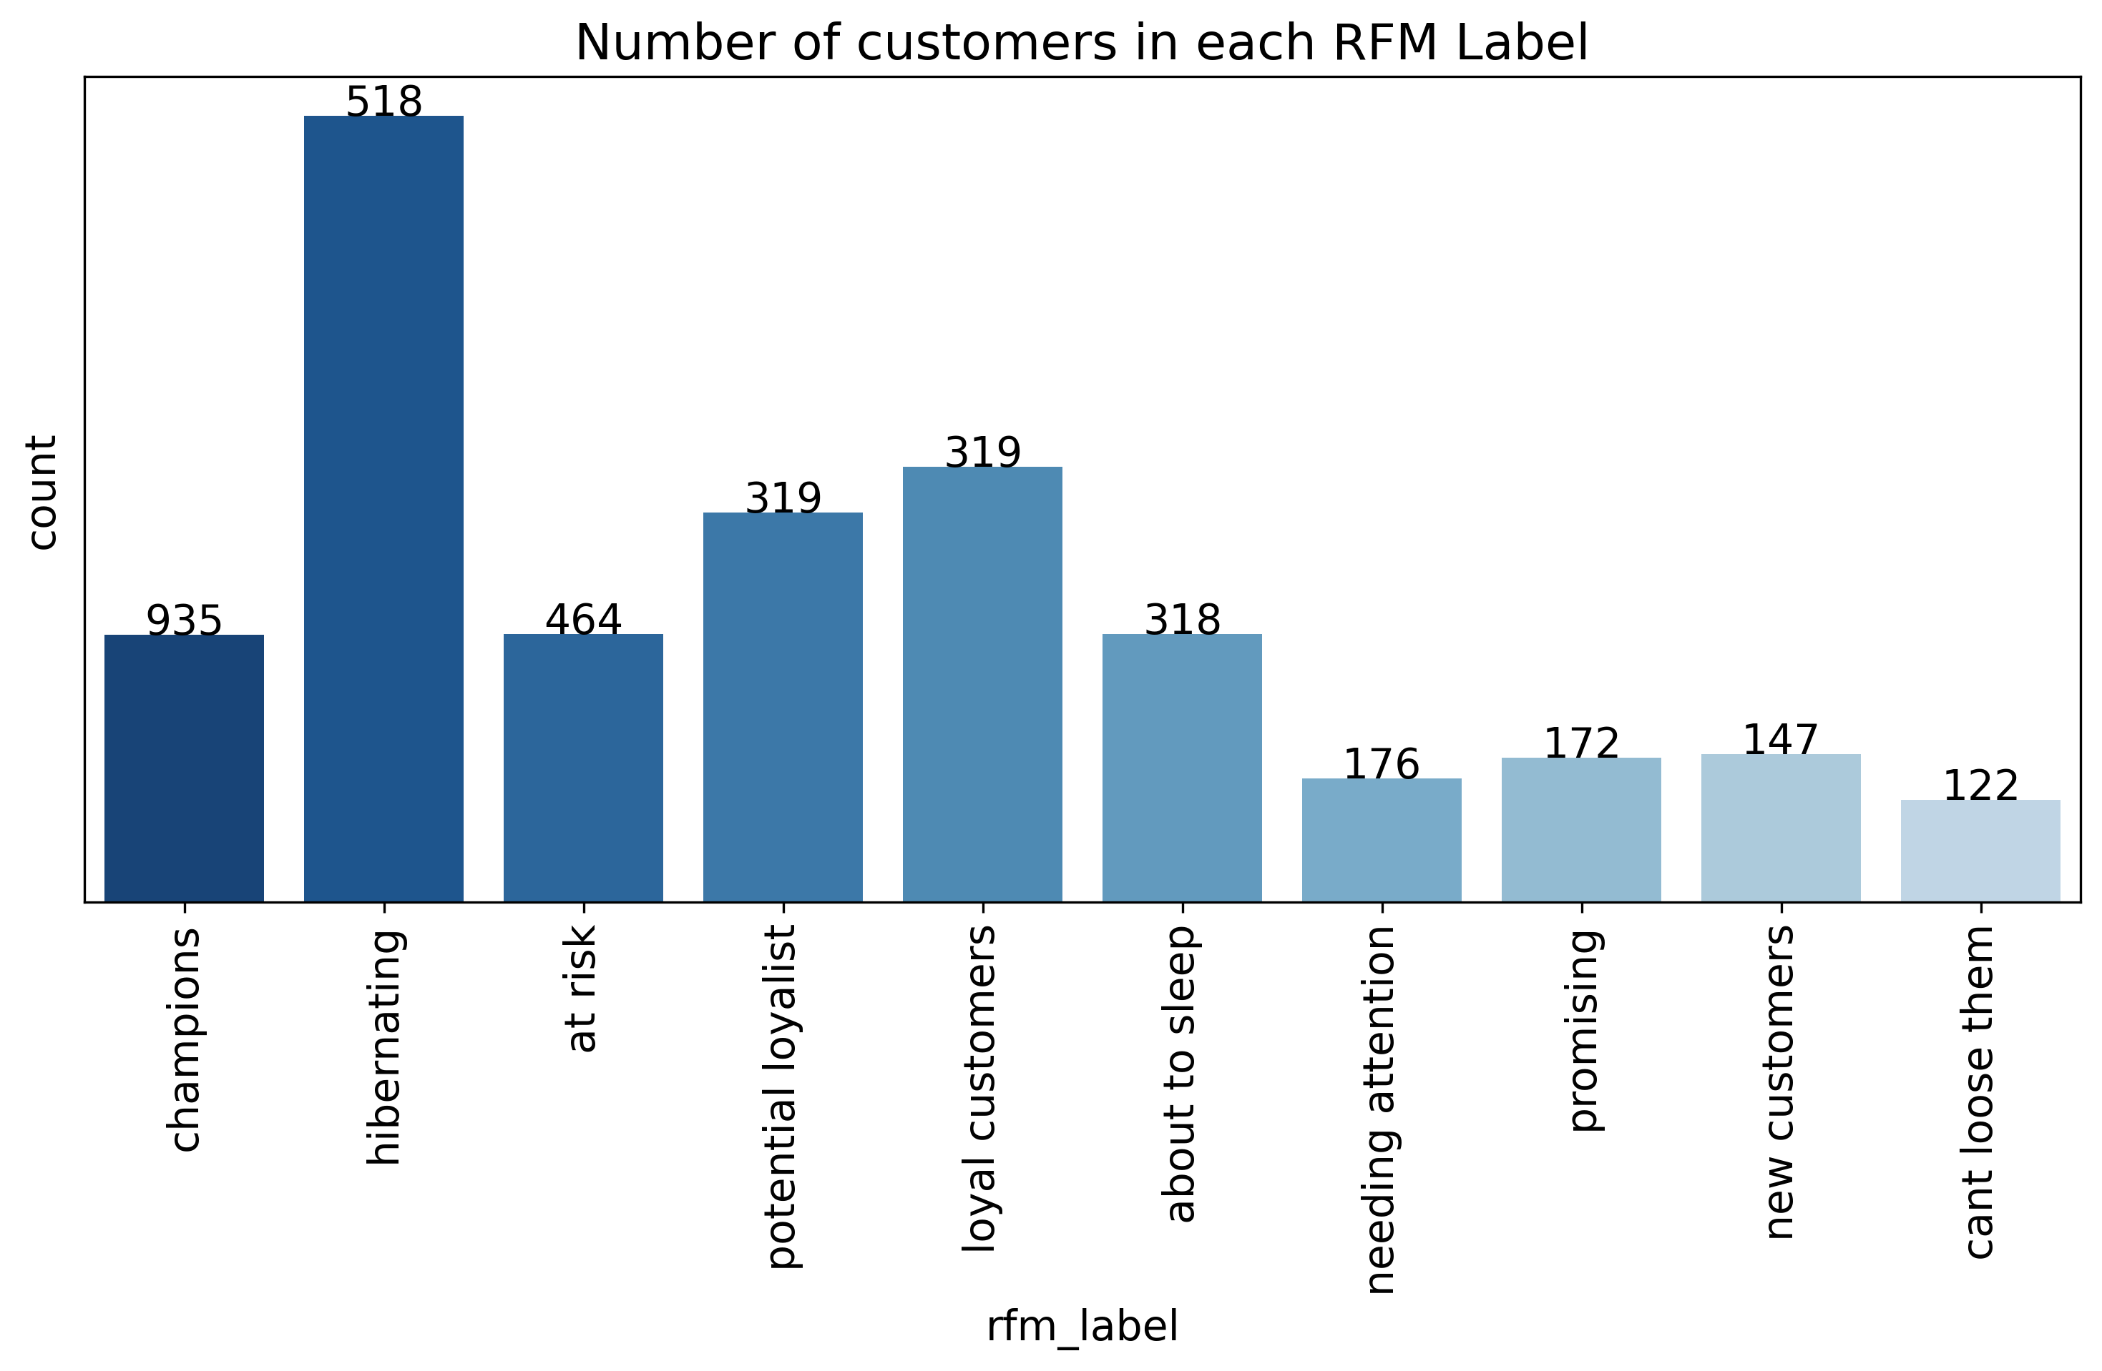
Model Development
RFM model
In order to target the right customers with the right campaigns RFM customer segmentation is needed. If the customer bought in recent past (recency), he gets higher points. If he bought many times (frequency), he gets higher score. And if he spent a lot of money (monetary), he gets more points.​

Slide 7
Interpretation
Customer Segment | Description | Retention Strategies
Loyal Customers | Valuable segment that accounts for around half of all customers. Highly engaged and likely to make repeat purchases. | Provide excellent customer service, personalized offers, and rewards programs.
Potential Loyalists | Similar to loyal customers, highly engaged and likely to make repeat purchases. | Provide excellent customer service, personalized offers, and rewards programs.
Champions | Highly profitable customers, highly loyal to the brand. | Give special treatment such as exclusive offers, early access to new products, and personalized communication.
Hibernating | Customers that the company has lost touch with. | Reactivate through a personalized outreach strategy, such as special offers, win-back incentives, and personalized communication.
At-risk | Recent customers who have not engaged with the brand as much as before. | Offer personalized recommendations, incentivize repeat purchases, and offer loyalty rewards to keep them engaged.
Potential | Customers who have made one or two purchases but have not demonstrated a strong attachment to the brand. | Target with personalized communication, special offers, and incentives to encourage them to make repeat purchases.

Slide 8
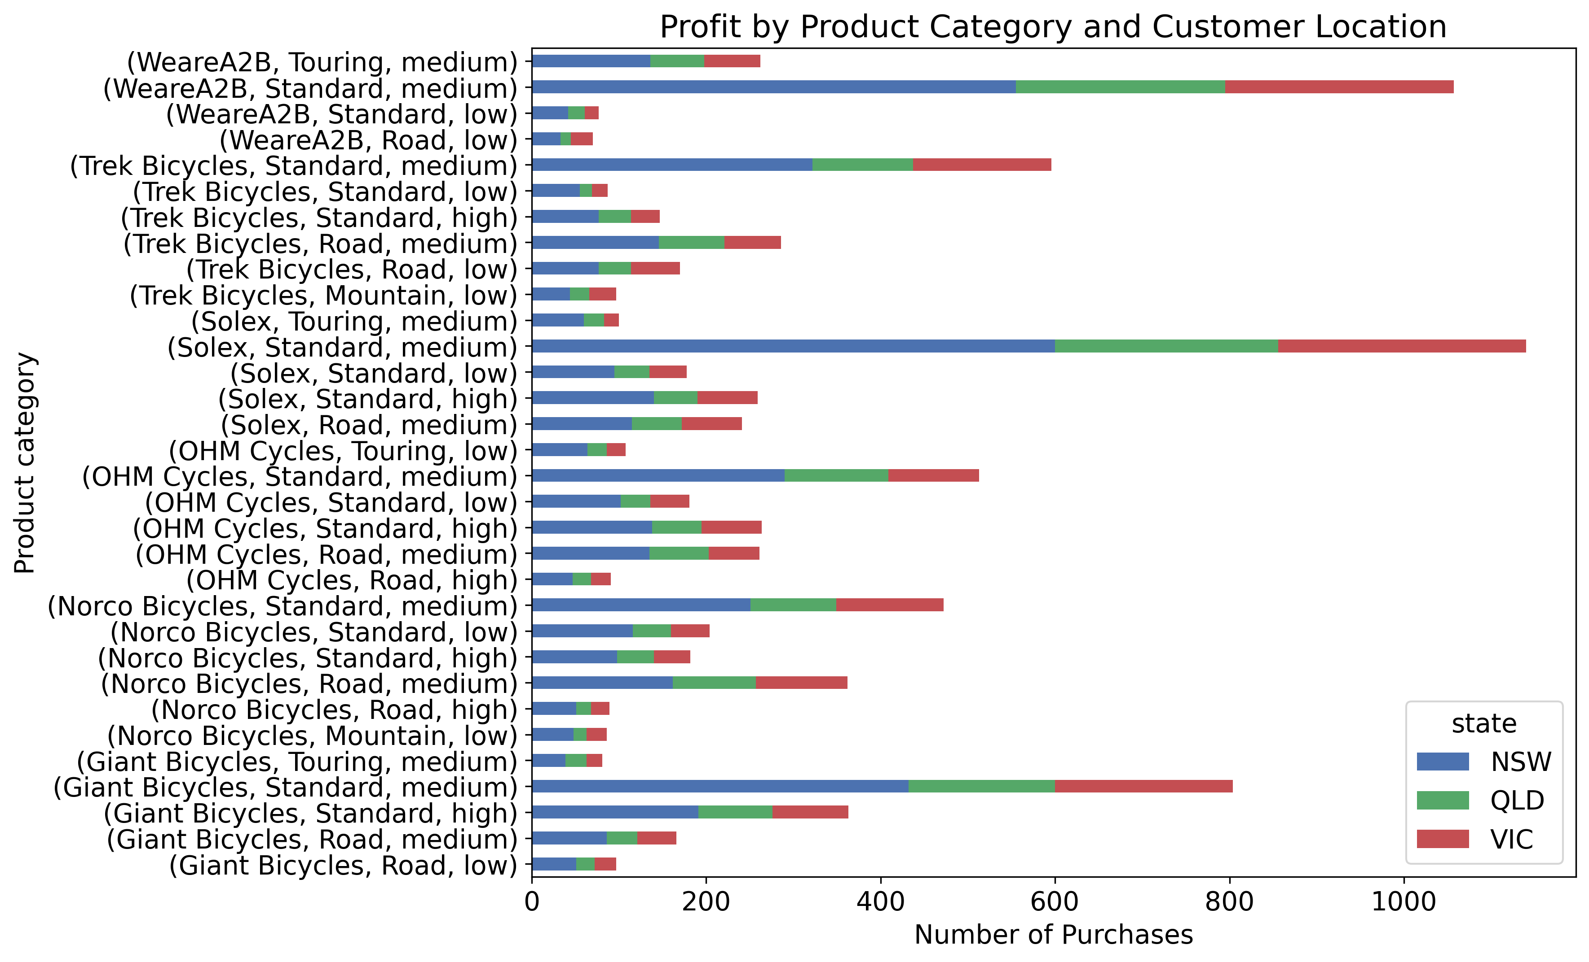
Interpretation
Which product made a good profit and where does the sale come from ?

Slide 9
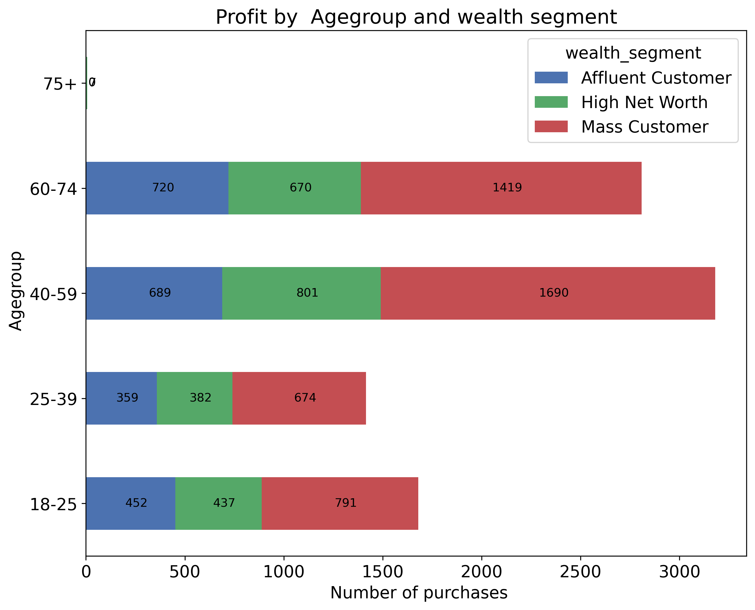
Interpretation
Which Age group and wealth segment contributed for profit?

Slide 10
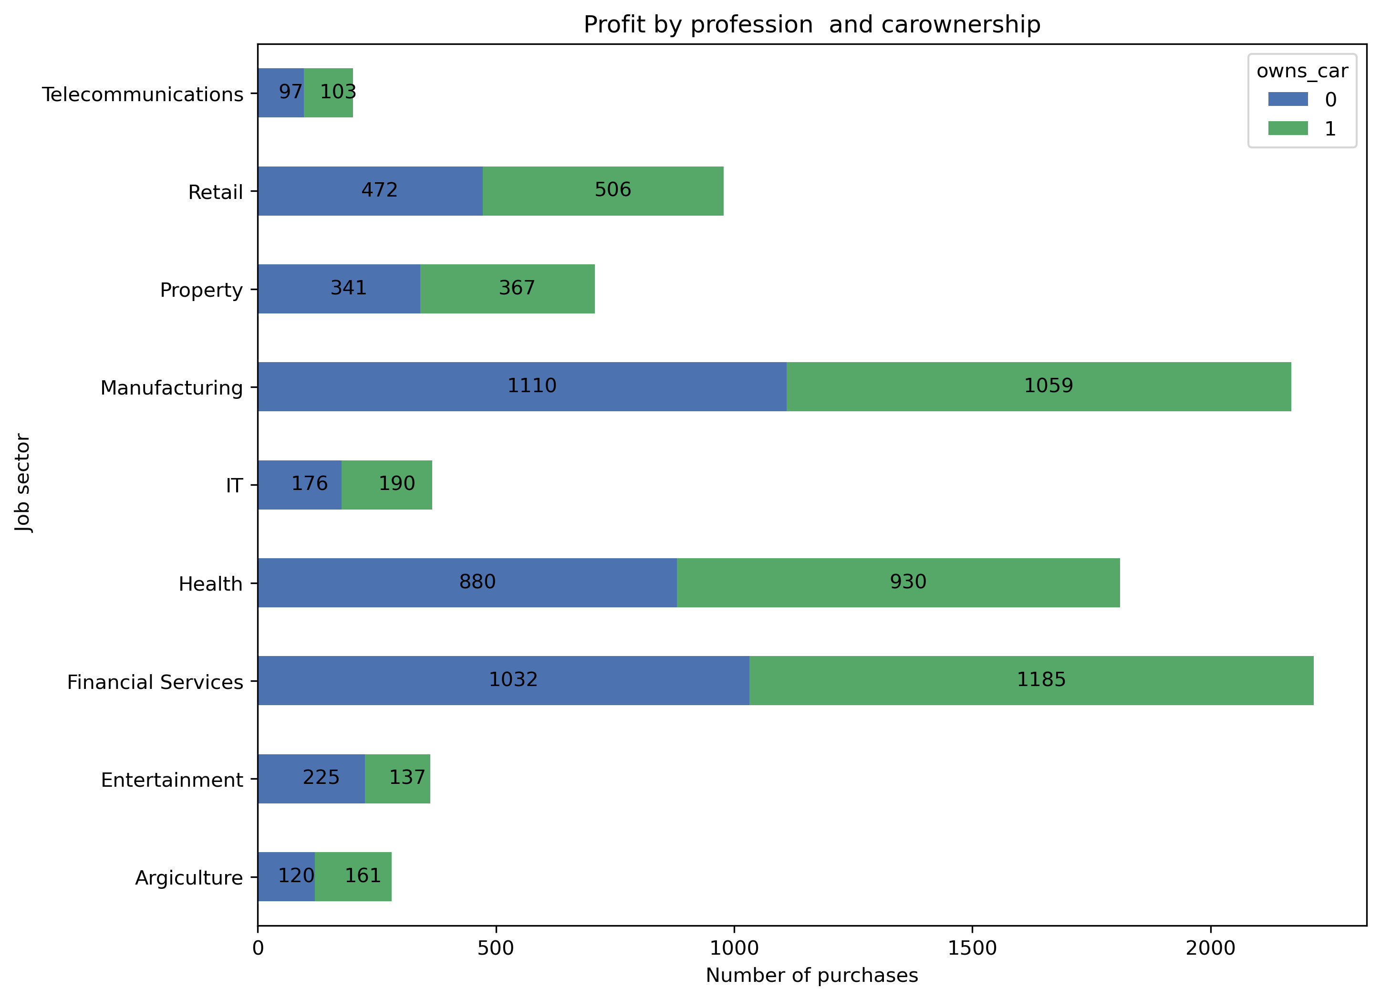
Interpretation
Ownership of car affects our profit? Which job category buys more?
0 – No car
1- With car

Slide 11
Interpretation
Target new customers criteria
State : NSW
Wealth segment: Mass customers
Age group: 40-75
Gender : Female
Job sector: Financial sector
Brand : Solex band in standard product line and a medium product class.

Slide 12
Note: The data and information in this document is reflective of a hypothetical situation and client. This document is to be used for KPMG Virtual Internship purposes only.
Thank you

